Slide 1





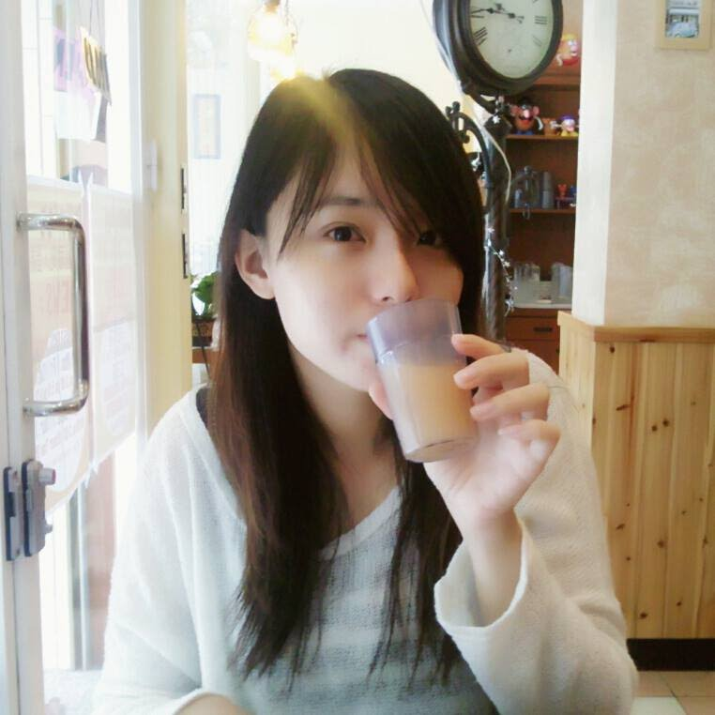


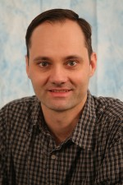

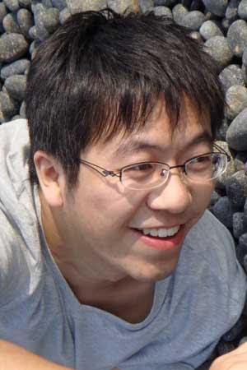
Multimodal Object Detection via Probabilistic Ensembling
Yi-Ting Chen*
Jinghao Shi*
Zelin Ye*
Christoph Mertz
Deva Ramanan#
Shu Kong#
Notes:
Good morning everyone. We are Shi jinghao and chenyiting. Our capstone project is object detection in infrared images. Our advisors are Professor deva ramanan, christoph mertz and kongshu.Our sponsor is Argo AI. Okay, let's get started!

Slide 2
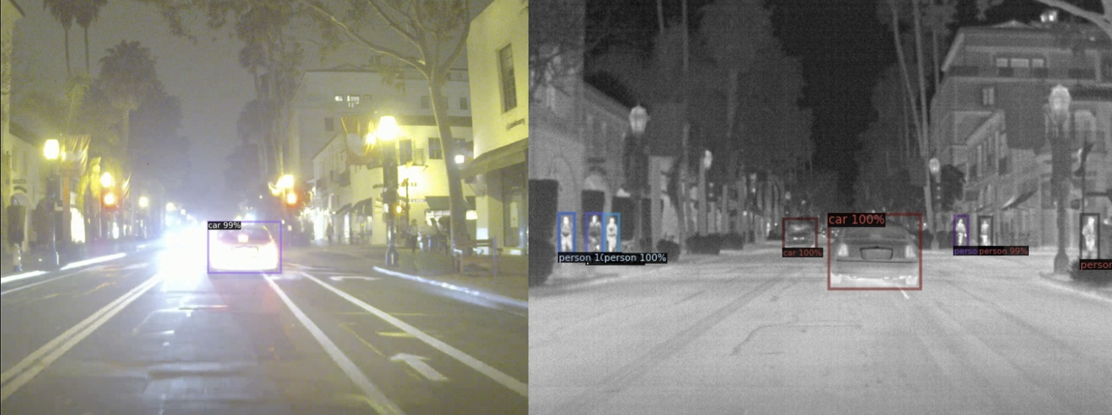
Motivation
Night scene
Undetected in RGB
Multimodal Object Detection via Probabilistic Ensembling, ECCV22

Slide 3
Motivation
Night scene (RGB)
Undetected in RGB
Multimodal Object Detection via Probabilistic Ensembling, ECCV22

Slide 4
Motivation
Night scene (RGB + Thermal)
Undetected in RGB
Multimodal Object Detection via Probabilistic Ensembling, ECCV22

Slide 5
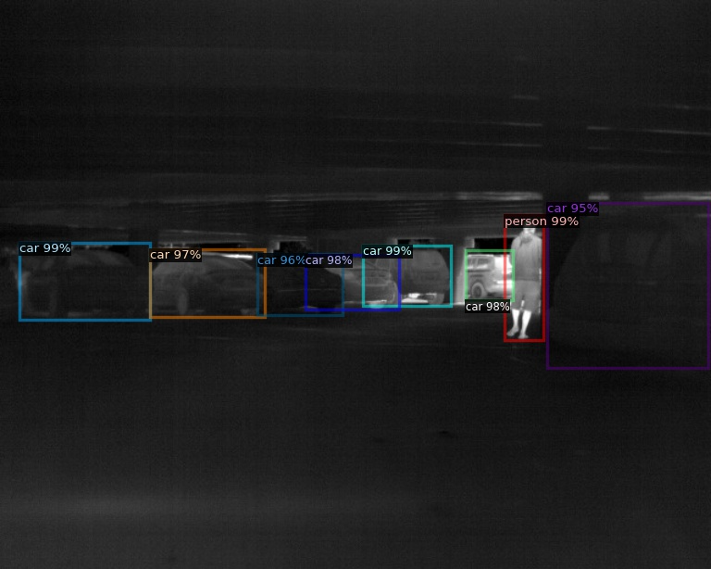
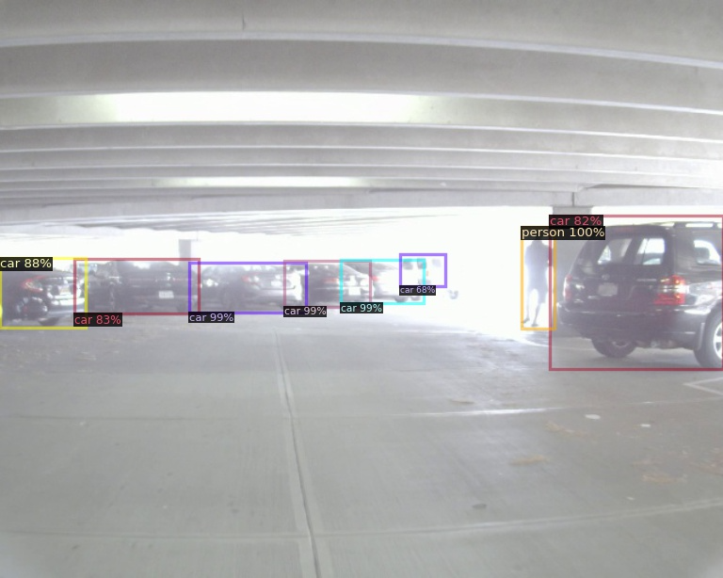
Motivation
High Dynamic Range scene
Undetected in RGB
Multimodal Object Detection via Probabilistic Ensembling, ECCV22

Slide 6
Motivation
High Dynamic Range scene (RGB)
Undetected in RGB
Multimodal Object Detection via Probabilistic Ensembling, ECCV22

Slide 7
Motivation
High Dynamic Range scene (RGB + Thermal)
Undetected in RGB
Multimodal Object Detection via Probabilistic Ensembling, ECCV22

Slide 8
Motivation
RGB and Thermal modalities are COMPLEMENTARY to each other
Multimodal Object Detection via Probabilistic Ensembling, ECCV22

Slide 9
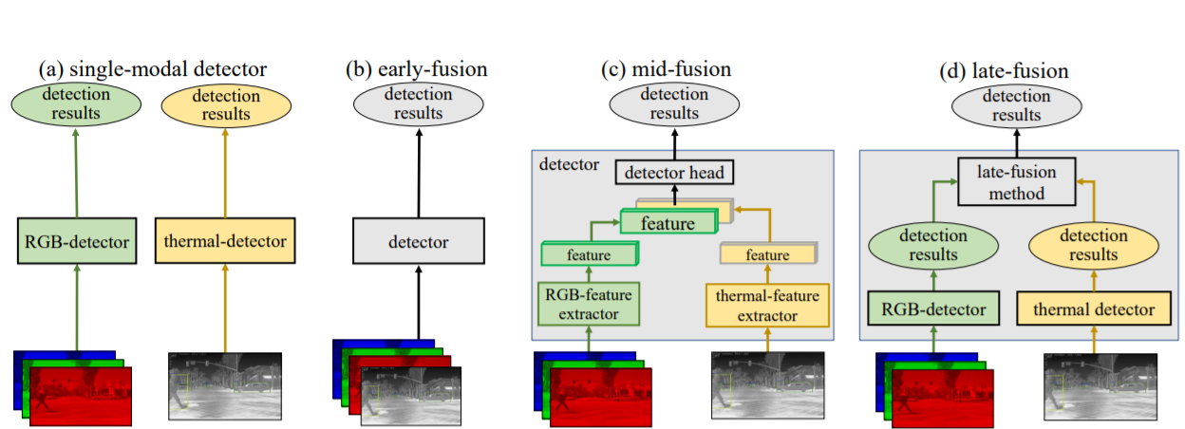
Multimodal Fusion Strategy
Multimodal Object Detection via Probabilistic Ensembling, ECCV22

Slide 10
Multimodal Fusion Strategy
Multimodal Object Detection via Probabilistic Ensembling, ECCV22

Slide 11
Multimodal Fusion Strategy
Multimodal Object Detection via Probabilistic Ensembling, ECCV22

Slide 12
Multimodal Fusion Strategy
Multimodal Object Detection via Probabilistic Ensembling, ECCV22

Slide 13
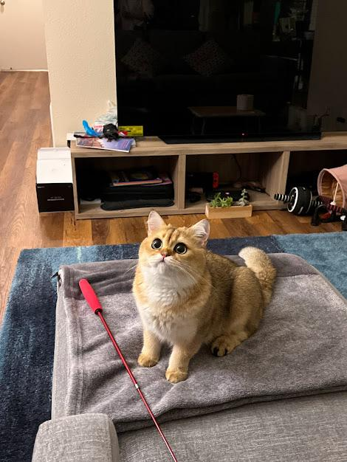
Late Fusion
Score fusion
Fuse (0.96, 0.98)
Box fusion
Fuse
cat, 0.96
cat, 0.98
cat, 0.98
Multimodal Object Detection via Probabilistic Ensembling, ECCV22

Slide 14
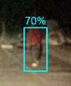
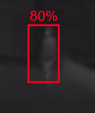
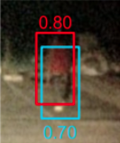
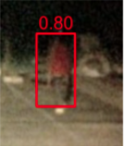
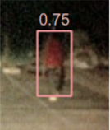
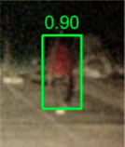
Score Fusion
Pooling
Pool all detections
NMS
Find overlapping boxes, assign highest scores
Avg
Find overlapping box, assign average scores
ProbEn
Find overlapping boxes, assign Bayesian scores
RGB
Thermal
Pooling
NMS
Avg
ProbEn
Multimodal Object Detection via Probabilistic Ensembling, ECCV22

Slide 15
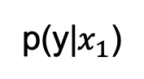
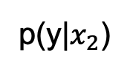
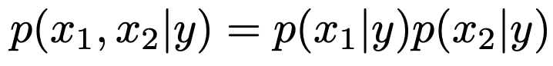
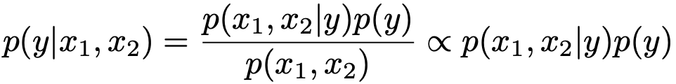
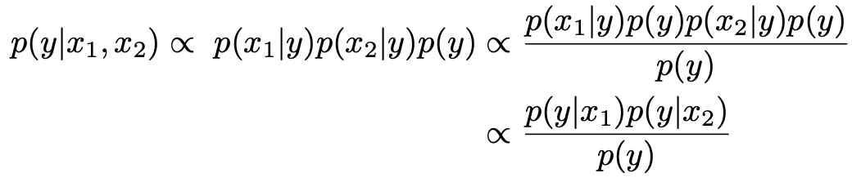
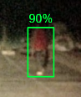
Probabilistic Ensemble (ProbEn)
Measurement
Assume conditional independence
Given multimodal measurement
Bayes rule
RGB
Thermal
Late fusion
ProbEn
Multimodal Object Detection via Probabilistic Ensembling, ECCV22

Slide 16
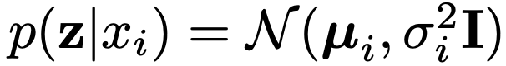
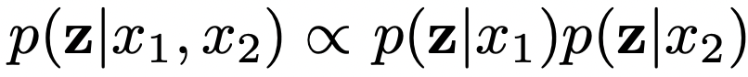
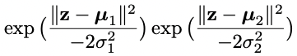
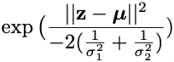
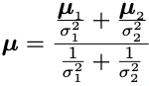
Box Fusion
Assume Gaussian posterior
Conform with conditional independence
p(z|x1)
p(z|x2)
merge
cat, 0.98
where
Multimodal Object Detection via Probabilistic Ensembling, ECCV22

Slide 17
Experiments
Multimodal Object Detection via Probabilistic Ensembling, ECCV22

Slide 18
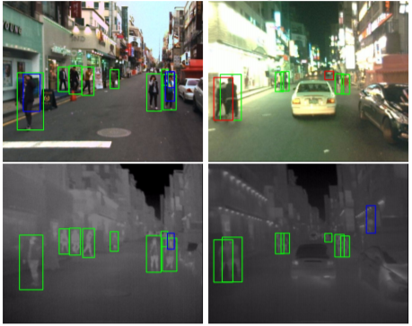
KAIST Dataset
day scene night scene
RGBT aligned dataset
Low resolution
Single class: pedestrian
Metric: log average miss rate (LAMR)
Middle Fusion
ProbEn
*true positives, false negative and false positives.
Multimodal Object Detection via Probabilistic Ensembling, ECCV22

Slide 19
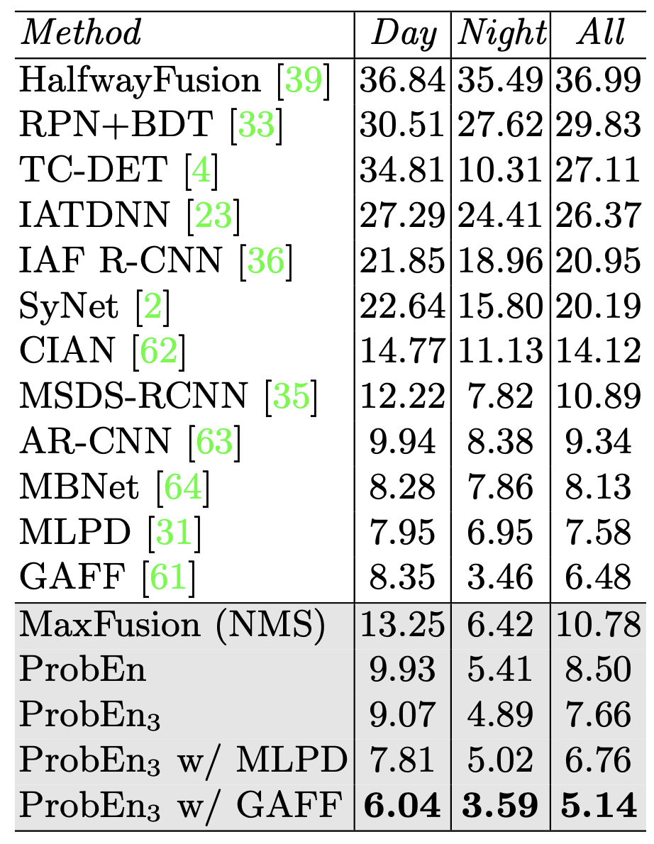
KAIST Dataset
day scene night scene
SOTA comparison
Middle Fusion
ProbEn
*true positives, false negative and false positives.
Multimodal Object Detection via Probabilistic Ensembling, ECCV22

Slide 20
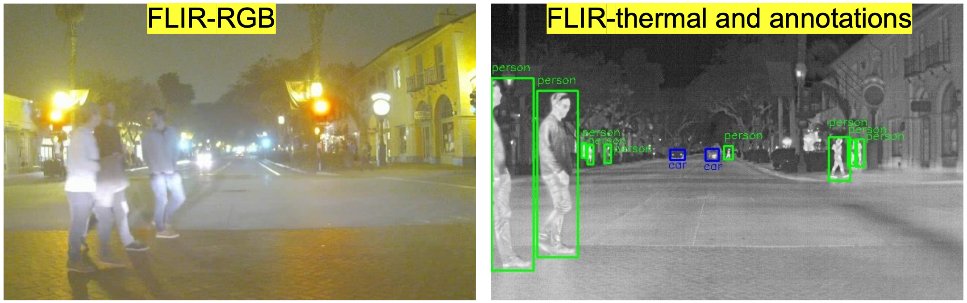
FLIR Dataset
RGBT unaligned dataset
High resolution
Classes: pedestrian, car, bike
Metric: mean average precision (mAP)
T=0
T=0
Multimodal Object Detection via Probabilistic Ensembling, ECCV22

Slide 21
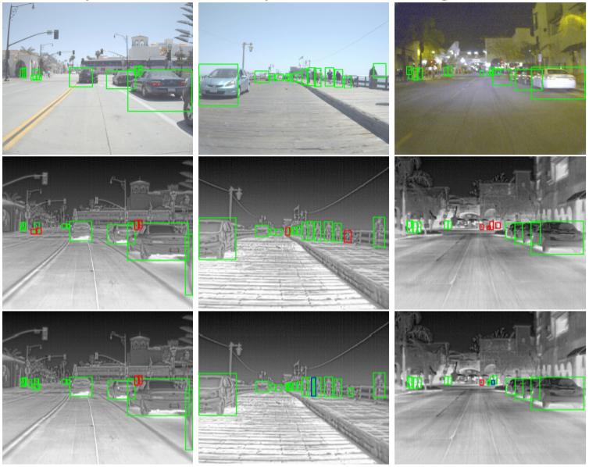
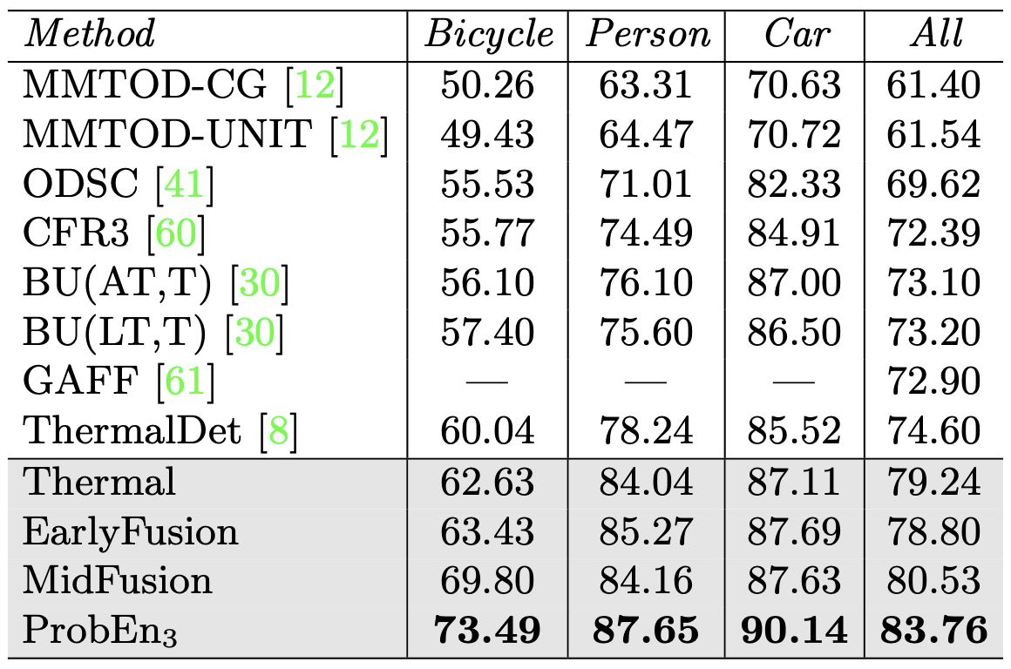
FLIR Dataset
day scene night scene
SOTA comparison
(mAP⬆: mean Average Precision)
*true positives, false negative and false positives.
Multimodal Object Detection via Probabilistic Ensembling, ECCV22

Slide 22
Thanks & QA
Multimodal Object Detection via Probabilistic Ensembling, ECCV22

Slide 23
Multimodal Object Detection via Probabilistic Ensembling, ECCV22

